Slide 1
CONTEXTUAL MEDICINE SIG
INAUGURAL SYMPOSIUM
ACBS World Conference 11
Sydney Australia 2011
Rob Purssey
Functional Contextual Psychiatrist
Kelly Wilson
Contextual Behavioral Scientist
Julian McNally
Psychologist, ACT Therapist
Tony Biglan
Contextual Behavioral Scientist - discussant

Slide 2
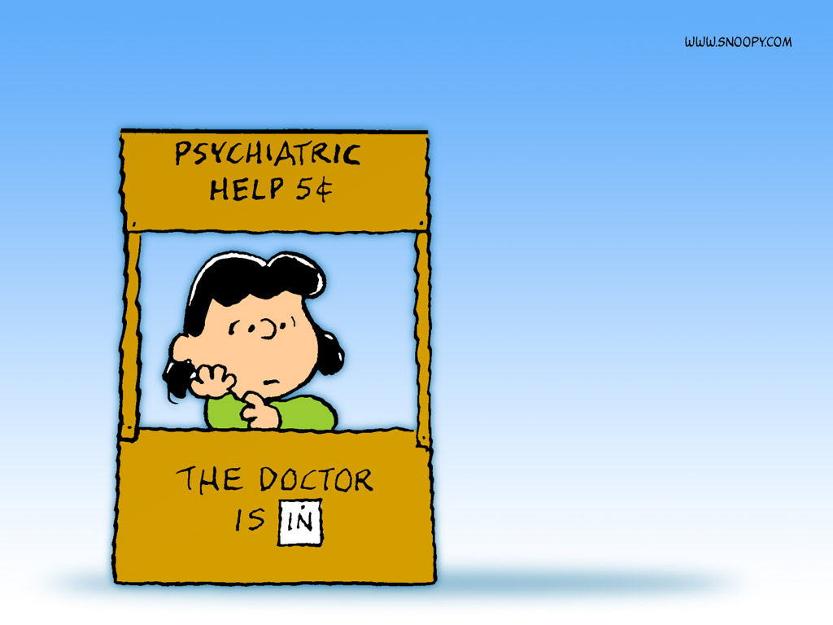
(FUNCTIONAL) CONTEXTUAL MEDICINE
- strategy, history, purpose, progress
Dr Robert Purssey MBBS FRANZCP
Functional Contextual Psychiatrist
Clinical Senior Lecturer, Uni of Qld
Brisbane ACT Centre, Queensland
Notes:
2

Slide 3
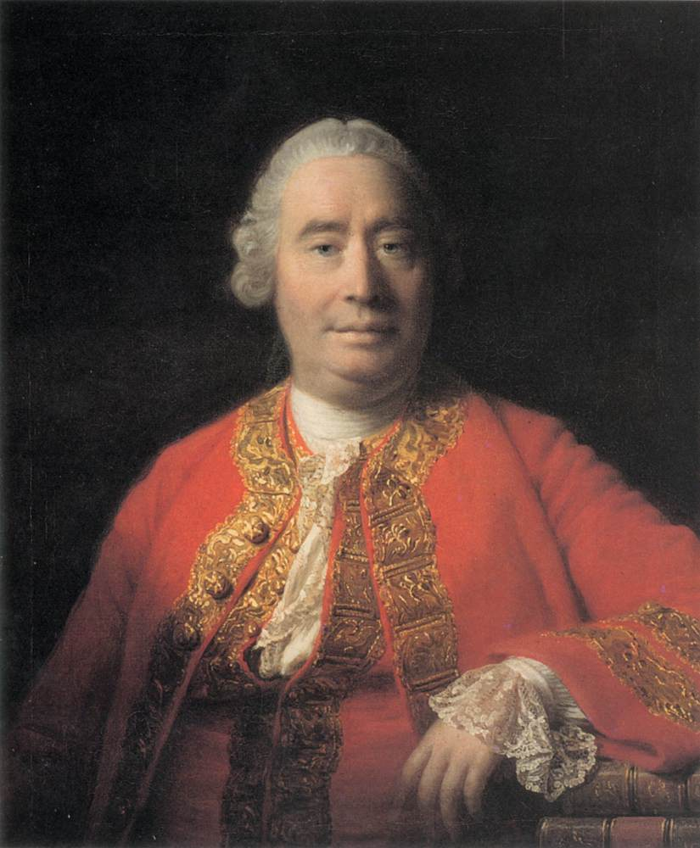
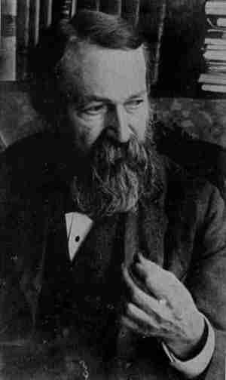
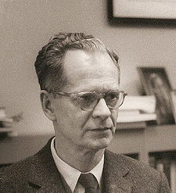
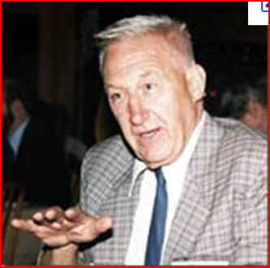
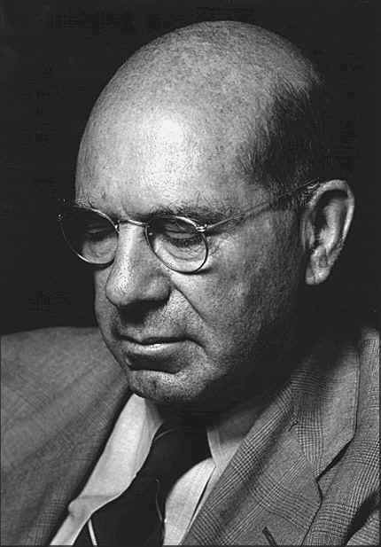

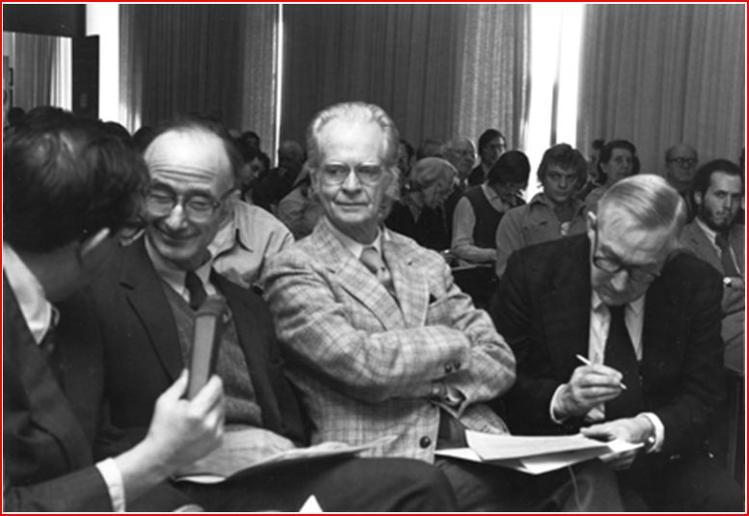
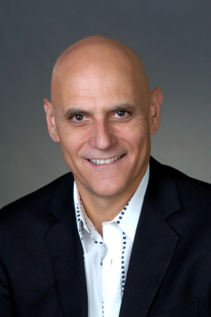

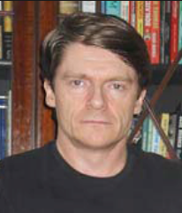
(FUNCTIONAL) CONTEXTUAL MEDICINE
- strategy, history, purpose, progress
An approach that satisfies scientists and practitioners
Unites biological, cognitive and behavioral along with evolutionary science
Opens exciting avenues in our ability to understand how people work, & help them.
David Hume
Ernst Mach
BF Skinner
Peter Dews
Stephen Pepper
Linda Parrot Hayes
Steven Hayes
Kelly Wilson
Dermot Barnes-Holmes
JR Pappenheimer, BF Skinner, PB Dews
Notes:
David Hume, Ernst Mach, Charles Darwin, JR Kantor, BF Skinner, PB Dews, Stephen Pepper, Steven C Hayes, Kelly G Wilson, JR Pappenheimer, Skinner and Dews.

Slide 4


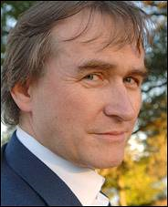
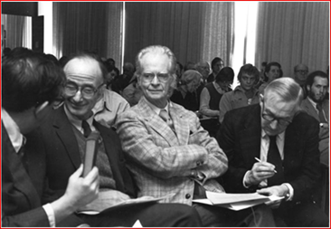

(FUNCTIONAL) CONTEXTUAL MEDICINE
- strategy, history, purpose, progress
Simon Dymond
Robert Whelan
Michael Schlund
David Healy
JR Pappenheimer, BF Skinner, PB Dews
Alan Poling
Notes:
Simon Dymond, Robert Whelan, Michael Schlund, Pappenheimer, Skinner, Dews, Alan Poling, David Healy

Slide 5
CM SIG – “Topics of Interest” - ACBS
Human physiology, neuroscience, medicine, and their relations within the broader field of evolutionary science.
Developing CBS-based case conceptualization … integrated with models and language familiar to medical practitioners.
Functional contextual study of the effect of drugs on human behavior - conceptual, research, and clinical.
Public health, socio-cultural, and economic issues relevant to practices of medicine incl. prescribing practices, health systems.
“I take Contextual Medicine to be an exploration of the role of biological processes and medical issues in human functioning from a functional, process-focussed, systemic, contextual viewpoint.”
Steve Hayes, from a CM List post 15/04/2013

Slide 6
(FUNCTIONAL) CONTEXTUAL MEDICINE
Winds of change in strategy in Medicine and Psychiatry
What does it mean to “be a doctor”, a healer?
Strategic (philosophical) foundations, (not) including history
Contextual Medicine = consistent behavior / biology science
Progress in Contextual Behavioral Neuroscience to mid 2013
Contextual Medicine – Organisational Practices
Clinical to follow: Kelly Wilson on CM medication / societal level, and Julian McNally on CM clinical interaction level.

Slide 7
Winds of change in strategy in Medicine and Psychiatry

Slide 8
Winds of change in the mainstream?
PLoS MEDICINE Podcast 2009 Prof Bruce Lanphear - new editorial vision
New focus on the social, environmental and political determinants of health.
Over focussed on drug trials, journals reliant on Pharma, Academics focused on grant dollars. Lost focus on the underlying determinants of health and disease.
Prevalent diseases particularly in developed/ing societies can be linked to industrial pollutants, to environmental chemicals (? particularly medications, see Anatomy, Pharmageddon) → “We have a stone in our shoe”
Heart disease, asthma, diabetes, “cholesterol”, psychopathology, chronicity...
“The Second Coming of the Sanitarians”, heroes of the 1800’s, early 1900’s Florence Nightingale, John Snow →dramatic public health improvements occurred before vaccinations and antibiotics: see Pharmageddon !!!

Slide 9
2009 PLoS MEDICINE Podcast Bruce Lanphear
Does the prevailing, dominant model of medicine get us where we want to go?
No it won’t. Not until we address the social, environmental and political determinants of health will we have the impact that we really want.
We need respectful irreverence. To question the existing models. Are they doing what we want them to do? Are they serving the public? Clearly they are not!
Journals, editors, are clearly beholden to the pharmaceutical industry.
Science must be more accessible to people, and serve them, globally. Via blogs, interactive sites, within the developed and developing world.
Protect children from environmental influences – accelerate this process by public engagement. Public pay for the science, they should have access.
2013 – RIAT Restoring Invisible and Abandoned Trials: A Creative Approach to a Public Good; Now a Creative Approach to Implementation is Needed
Commitment by PLoS Medicine and BMJ to publish findings of reanalyses of drugs such as paroxetine, quetiapine, and gabapentin, oseltamivir and clopidogrel.
Notes:
Does the prevailing or dominant model of medicine get us where we want to go?
What we’ve recognised is, no it won’t. Not until we recognise the social, environmental and political determinants of health will we have the impact on worldwide disease prevention that we really want.
We need respectful irreverence. We need to question the existing models. Are they doing what we want them to do? Are they serving the public?
Many of the journals, editors, have become beholden to the pharmaceutical industries that populate their pages. We need to make science accessible to people, and to serve them. Via blogs, interactive sites, especially to the 3rd world.
2013 – RIAT Restoring Invisible and Abandoned Trials: A Creative Approach to a Public Good; Now a Creative Approach to Implementation is Needed
Commitment by PLoS Medicine and BMJ to publish findings of reanalyses of drugs such as paroxetine, quetiapine, and gabapentin, oseltamivir and clopidogrel

Slide 10
Anatomy, RxISK, alltrials, RIAT,DSM
Anatomy of an Epidemic – madinamerica.com ; 82 US writers, 26 foreign correspondents, incl. Moncrieff, Healy, Dr’s, patients, SW’s, Lawyers, Sociologists, parents.
RxISK –S/E’s are being elucidated, useful lessons learnt.
Alltrials – extraordinary support across organisations
RIAT – Restoration of Incomplete and Abandoned Trials supported by BMJ, PLoS, wide coverage in the media
DSM 5 fiasco – the Emperor’s garb ever more apparent

Slide 11
Epigenetic Mechanisms in Psychiatry
Akbarian and Nestler, Neuropsychopharmacology Reviews 2013
6th issue of Neuropsychopharmacology Reviews - `neuroepigenetics'
A `molecular bridge' → context shapes genetics over the lifespan
Epigenetics center stage in medicine, incl. neurology and psychiatry.
For basic and clinical neuroscience, important insights fuel interest
(i) many epigenetic markings are `plastic' throughout brain development,
(ii) some chromatin-modifying drugs—exert profound behavioral effects
CONTEXT and BEHAVIOR = FUNCTIONAL PROCESSES WHICH PROFOUNDLY AND DYNAMICALLY INFLUENCE BIOLOGY THROUGH THE LIFESPAN.
Notes:
6th issue of Neuropsychopharmacology Reviews focused on epigenetics.
A `molecular bridge' by which external (environmental) and internal factors mold and shape genetic material throughout the brain and peripheral tissues over the entire lifespan of an organism.
Over the past 15 years, epigenetics become center stage in many areas of translational and experimental medicine, incl. neurology and psychiatry.
For basic and clinical neuroscience, there are important emerging insights that fuel interest and excitement for `neuroepigenetics':
(i) many epigenetic markings are `plastic' throughout brain development, with ongoing, highly dynamic regulation in neurons and other cell types;
(ii) some chromatin-modifying drugs—exert profound behavioral effects

Slide 12
NIMH's new stance and CBS research
Steve Hayes- RFT List post reply June 2013
Epigenetic regulation of the glucocorticoid receptor in human brain associated with childhood abuse. Nature Neuroscience (2009)
Biological system impacted over years by a psychosocial event,
plus evidence of epigenetic regulation by psychosocial methods.
→ psychological and biological function in glucocorticoid receptors.
Examine functions in multiple evolutionary time frames.
Link functions to things like experiential avoidance.
Voila. Genetics can be our ally. It is not "genes made me do it".
All the above coherent, tightly linked from an FC / CM perspective
Notes:
Epigenetic regulation of the glucocorticoid receptor in human brain associates with childhood abuse Nature Neuroscience (2009)
A biological system impacted over many years by a psychosocial event.
Plus evidence of altering (epigenetic regulation) via psychosocial methods.
Explore the psychological and biological function of these changes in glucocorticoid receptors.
Examine these functions in multiple evolutionary time frames.
Link these functions to things like experiential avoidance.
Voila. Genetics can be our ally. It is not "genes made me do it".
All the above coherent, tightly linked from an FC / CM perspective
Steve Hayes RFT List post June 2013

Slide 13
What does it mean to
“be a doctor”, to be a healer?

Slide 14
Declaration of Geneva (WMA, 2006)
- modern version of Hippocratic Oath
As a member of the medical profession:
I pledge … to the service of humanity;
I will give my teachers the respect that is their due;
I will practise with conscience;
The health of my patient will be my first consideration;
I will maintain the honour and the noble traditions of the medical profession;
I will not permit age, disease, creed, etc or any other factor to intervene between my duty and my patient;

Slide 15
PRIMUM NON NOCERE
FIRST DO NO HARM
Yet…
Anatomy of an Epidemic – Robert Whitaker
Pharmageddon – David Healy
And…
locally, here in Australia, a similar picture

Slide 16
Trends in psychotropic meds
in Australia: 2000 - 2011
Stephenson et al, Aust N Z J Psychiatry 2012
ANTIDEPRESSANTS DOUBLED
“ATYPICAL” ANTIPSYCHOTICS TRIPLED
ADHD MEDS DOUBLED
XANAX DOUBLED
LAMOTRIGINE DOUBLED
AND AUSTRALIAN’S MENTAL HEALTH?
NO IMPROVEMENT
Changes in psychological distress in Australian adults 1995 - 2011.
Jorm and Reavley, Aust N Z J Psychiatry 2012

Slide 17
Strategic (philosophical) foundations
Winds of change → Contextual Medicine

Slide 18
Philosophy, ethics, medicine and health care: the urgent need for critical practice
Michael Loughlin et al, Journal of Evaluation in Clinical Practice 2010
First philosophy issue of the Journal of Evaluation in Clinical Practice
What is philosophy? Should health practitioners take it seriously?
From nature of clinical evidence to management, many answer ‘no’, refusing even to think about what it means.
It is acceptable to write about the nature of clinical knowledge and the proper relationship between scientific research and medical practice, while having no interest in epistemology and the philosophy of science
As though underlying questions about the nature, limitations and role of science in clinical practice were just too obvious to merit serious consideration.
EBM gives pride of place to RCTs and devalues theoretical models – a devaluation that would be incomprehensible to a physicist or biologist.
Validity of EBM's causal and knowledge claims are severely undermined.
Notes:
First philosophy issue of the Journal of Evaluation in Clinical Practice
What is philosophy? Should health practitioners, patients and policy makers take the subject seriously? From the nature of clinical evidence to the management of health services, many answer the second question with a resounding ‘no’, refusing even to think about the first .
It is deemed acceptable to write about the nature of clinical knowledge and the proper relationship between scientific research and medical practice, while professing no interest in epistemology and the philosophy of science, as though underlying questions about the nature, limitations and role of science in clinical practice were just too obvious to merit serious consideration.
EBM gives pride of place to RCTs and devalues theoretical models – a devaluation that would be incomprehensible to a physicist or biologist.
Validity of EBM's causal and knowledge claims are severely undermined.
18

Slide 19
Evidence: philosophy of science meets medicine
John Warrell Ph D Journal of Evaluation in Clinical Practice 2010
“A wise man proportions his belief to the evidence.” (David Hume)
“Any belief that the controlled trial is the only way would mean not that the pendulum had swung too far, but that it had come right off the hook.” (Austin Bradford Hill, Reflections on the Controlled Trial)
Following Hume, medicine, like any rational pursuit, should be based on evidence. What else should it be based on? Myth? Superstition?
It isn't a question of if medicine is – or should be – evidence-based.
The issues lie in the details: what exactly counts as evidence? Do certain kinds of evidence carry more weight than others? (And if so why?) And how exactly should medicine be based on evidence?
When it comes to these details, the evidence-based medicine (EBM) movement has got itself into a mess – or so it will be argued.
In order to start to resolve this mess, we need to go ‘back to basics’; and that means turning to the philosophy of science…

Slide 20
Philosophy of science – why bother?
… or perhaps? “Strategy” of science
Pre-analytic assumptions explicit → owning them
Attempting to eliminate incoherence in assumptions
Rules of evidence (or criteria for truth)
used to create, assess, and evaluate knowledge claims and theories
how otherwise to proceed effectively in science?
Coherence, less misunderstanding & pointless debate, productive comparisons / theory evaluations
PROGRESSIVITY OF SCIENCE, BUILDING THE WORK
Notes:
Nothing more than making your assumptions explicit, owning them, and attempting to eliminate incoherence between assumptions
Pre-analytic assumptions and rules of evidence (or criteria for truth) that are used to create, assess, and evaluate knowledge claims and theories → how otherwise to proceed effectively in science?
Improve coherence, reduce misunderstandings, avoid pointless debate, and allow productive comparisons and evaluations of theories
PROGRESSIVITY OF SCIENCE, BUILDING THE WORK
It can be difficult to fully appreciate the role philosophical (strategic) assumptions play in the development of theory,
science, and technology. This is particularly true in applied disciplines like medicine, where scholars
and practitioners often leave core assumptions unstated, cobble together patchwork theories or techniques in the
hope of embracing diverse perspectives, or trust that brute force empiricism will reveal all of the relevant facts.
Unfortunately, such practices make it difficult to clearly discern philosophical (strategic) differences and are unlikely to
contribute to the development of a coherent and progressive discipline. Those who do not specify their core
assumptions or claim that they have none are typically just adopting those of the mainstream culture; those who
carelessly integrate diverse theories run the risk of trying to combine mutually exclusive tenets and producing
little more than incoherence; and those who trust in merely amassing raw empirical data are advocating a
strategy that can be grossly inefficient, uncharacteristic of scientific research, and ill-suited to the development
of true technological / therapeutic innovation. Theories, and the philosophical / strategic assumptions that guide their construction and
evaluation, are the foundation of scientific and technological progress.
Fox, E. J. (2008). Contextualistic perspectives. In J. M. Spector, M. D. Merrill, J. van Merriënboer, & M. P.
Driscoll (Eds.) Handbook of research on educational communications and technology (3rd Ed.). (pp.
55-66). Mahwah, NJ: Lawrence Erlbaum Associates.

Slide 21
FUNCTIONAL CONTEXTUALISM
A philosophy of science and variant of contextualism that has as its primary goal →
The prediction and influence of events with precision, scope, and depth using
Empirically based concepts and rules.
It seeks the construction of knowledge that is
General, abstract, and spatiotemporally unrestricted, like a scientific principle
Yet also specific in particular circumstances
Notes:
‘Theory’ has a wide variety of meanings in intellectual discourse, but we will restrict our discussion to a
relatively simple interpretation: statements that are relatively precise and have relatively broad scope. Precision
refers to the number of ways a particular phenomena can be explained with a given set of analytic concepts (the
fewer, the better) and scope refers to the range of phenomena that can be explained with those concepts (the
wider, the better). Theories are valuable because they allow for conceptual economy and parsimony, provide
guidance for confronting new problems or situations, and prevent a discipline from becoming increasingly
disorganized and incoherent (Hayes, Strosahl, & Wilson, 1999) – from the above

Slide 22
MEDICAL SCIENCE including diagnosis, treatment, health systems
A human activity that has as its primary goal →
The prediction and influence of health and illness with precision, scope, and depth using
Empirically based concepts and rules.
It seeks the construction of knowledge and associated interventions / systems that are
General, abstract, and spatiotemporally unrestricted, like a scientific principle
Yet also specific in particular circumstances
Notes:
I would argue that there is complete overlap in the aims of clinical medicine and medical science with those of functional contextualism

Slide 23
CBS ‘truth’ = successful working
Science → rules for effective action, ‘true’ if yielding the most effective action possible” BF Skinner, About Behaviorism, 1974
A theory is true to the extent that it organises the behavior of scientists (or clinicians) → reach the goals of their science. Parts, relations and forces may be described, but parts are a useful fiction functionally describing aspects of the whole.
CBS = interested in pragmatic truth linked to stated goals, and nothing else. Principled disinterest in common sense “ontological truth” and great interest in pragmatic truth is consistent across all levels of CBS → RFT to ACT to CM.
NOT anti-ontological, NOR anti-realist, RATHER CBS is realist → as MONISTS we’re interested in the one “real” world, but there’s just one. “There is no cause nor effect in nature; nature has but an individual existence; nature simply is.” Ernst Mach
Theories are seen as hammers, not mirrors. They are for working with in chosen directions, not reflecting what is real.
Notes:
‘Theory’ has a wide variety of meanings in intellectual discourse, but we will restrict our discussion to a
relatively simple interpretation: statements that are relatively precise and have relatively broad scope. Precision
refers to the number of ways a particular phenomena can be explained with a given set of analytic concepts (the
fewer, the better) and scope refers to the range of phenomena that can be explained with those concepts (the
wider, the better). Theories are valuable because they allow for conceptual economy and parsimony, provide
guidance for confronting new problems or situations, and prevent a discipline from becoming increasingly
disorganized and incoherent (Hayes, Strosahl, & Wilson, 1999) – from the above

Slide 24
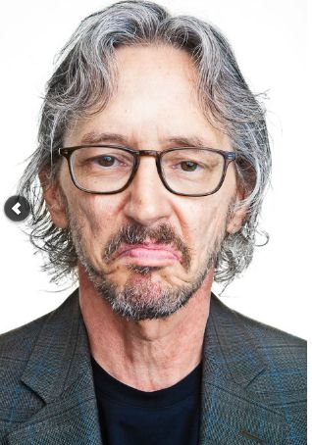
FC in Five Easy Pieces. Kelly G Wilson
? D.o.b.... 195x
Some notes on theoretical constructs. 2001
The following are some key points and underlying assumptions of our case:
1. Formulated constructs ought to be continuous with the events within the field of purported interest.
2. The ultimate validity of constructs is reducible to the extent of improvement in orientation to the field of interest they provide (i.e., enhanced prediction and influence [with precision, scope and depth])

Slide 25
FC by phil science geek – Kelly Wilson
3. Constructs ought not be confused with the crude events with which the scientist interacts
4. Constructs are never attributed ontological validity as result of any operational successes, rather they are maintained as operationally valid. The extent of this validity may be assessed according to the metric described in proposition 2
(i.e. improvement in orientation to the field of interest – prediction and control with precision, scope and depth).
5. Divergence from the above will at best be superfluous and at worst will draw the investigator’s efforts in directions unfruitful to the advancement of a given field

Slide 26
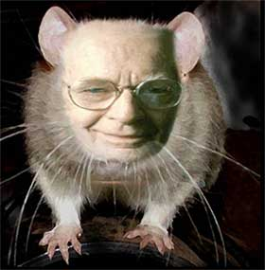
BF Skinner – About Behaviorism
It would be absurd for the behaviorist to contend that he is in any way exempt from his analysis. He cannot step outside of the causal stream and observe behavior from some special point of vantage, “perched on the epicycle of Mercury.”
In the very act of analyzing human behavior he is behaving. (1974)
Cumulative Record...

Slide 27
For the functional contextualist, biological events are not biological
Physiological events may be incorporated into a science of behaviour not as physiological offence per se, but as behavioural events.
Dermot Barnes Holmes 2003
i.e., the behaviour of physiologists in identifying physiological relations with behavioral measures may also be analysed as behaviour.
Notes:
Physiology = changes over time within the structure and function of a living organism in relation to context→ analysed within a functional contextual framework. If NOT, the goals and aims of the behaving scientist are overlooked: science does not “have values”.
This is frequently the case, and the goals and aims are generally mechanistic, reductionist and increasingly unhappily commercial. Naturally so, being behavior within a corporate context = profit.

Slide 28
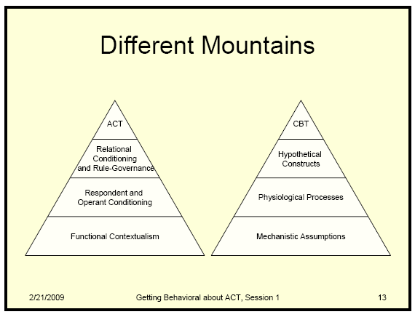
Assumptions, coherence, effectiveness
Structure and Function relations = FC Neuroscience / CM / RFT
Emotions, Motivation
Memory, Hallucinations
Brain circuits
Elemental realist
neuroscience
Notes:
Credit to Chad Drake for diagram
28

Slide 29
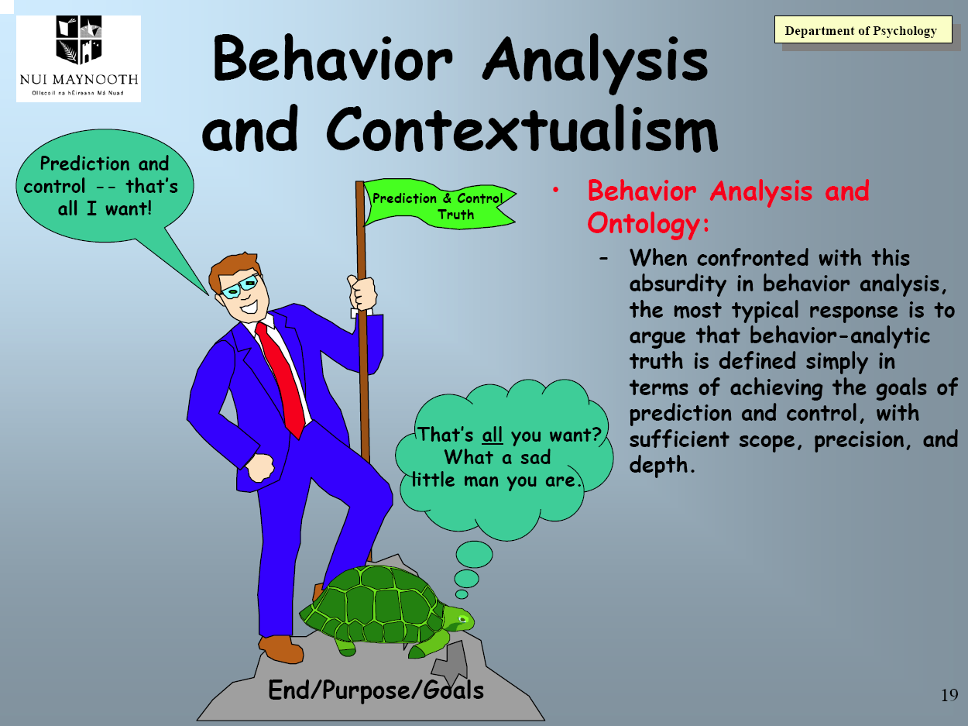
Notes:
29

Slide 30
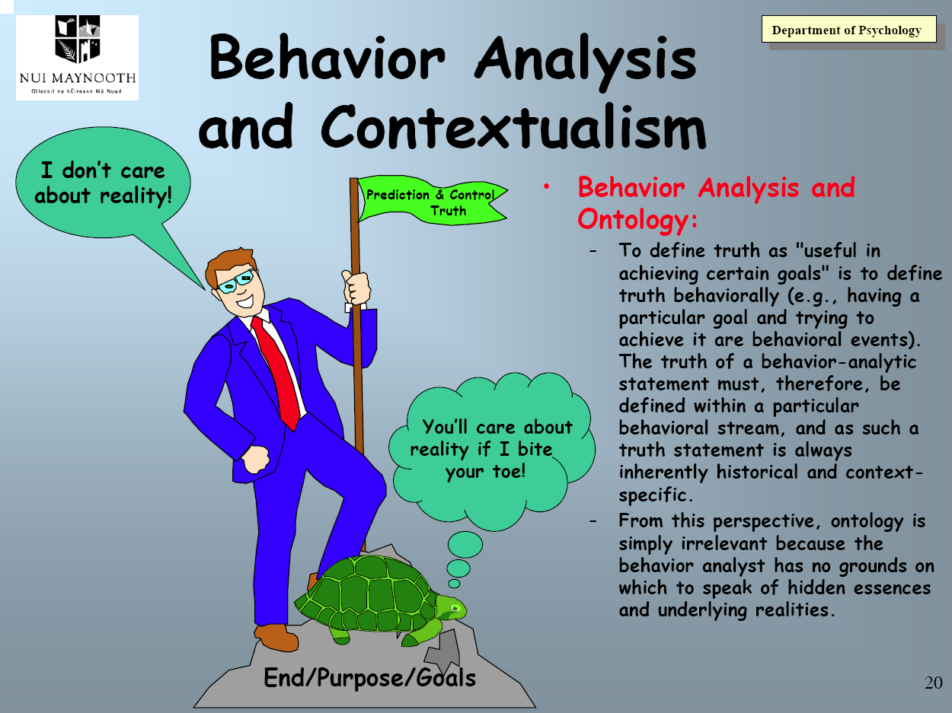
Notes:
30

Slide 31
i.e. but… the “realness” of drugs, neurotransmitters etc ???
Scientific laws... specify or imply responses and consequences.
They are not ... obeyed by nature but…by men that deal effectively with nature.
Laws of gravity do not govern the behavior of falling bodies…
… they govern those who correctly predict the position of falling bodies at given times.
(BF Skinner, 1969, p. 141)
Notes:
Scientific laws (and statements about observed phenomena including drugs, fMRI’s, neurones) ...
specify or imply responses and consequences.
They are not ... obeyed by nature but…
… by men that deal effectively with nature.
The formula s = 1/2 gt2 does not govern the behavior of falling bodies…
… it governs those who correctly predict the position of falling bodies at given times.
(BF Skinner, 1969, p. 141)
31

Slide 32
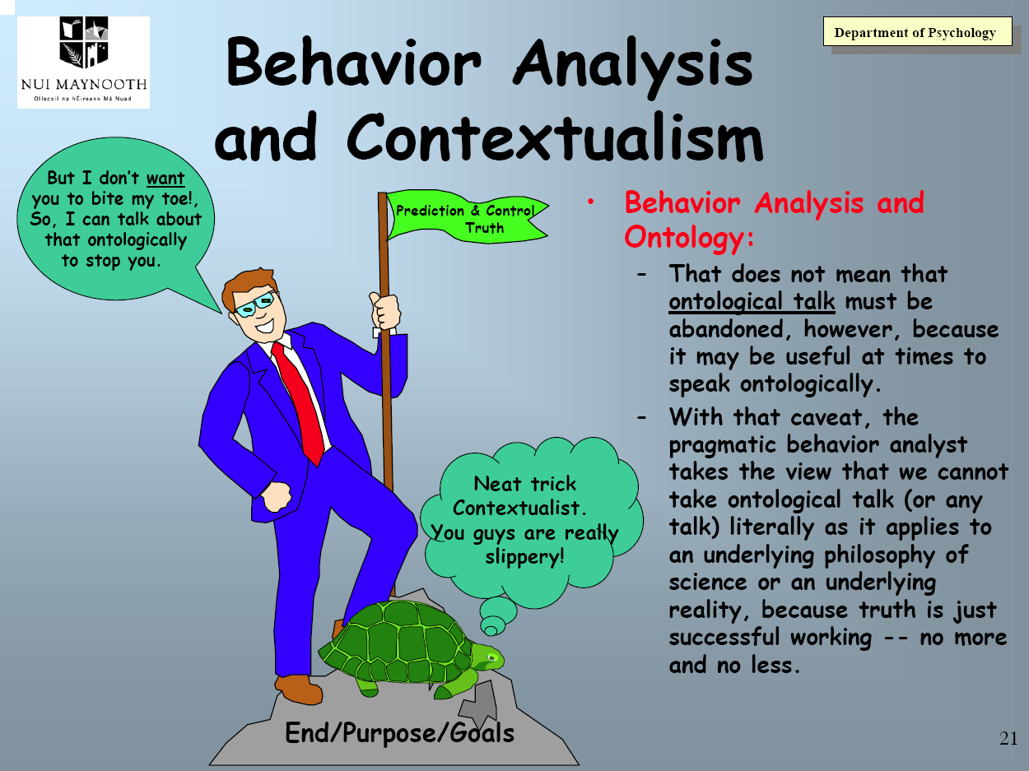
Notes:
Functional Contextualists - being really annoying ☺
FC view of aontology means ALL phenomena may be viewed functionally, incl biochemistry, from naming to physiology, osmosis and JR Pappenheimer, Mach and physics (bedrock of materialism), AND which may be “spoken of” mechanistically quite successfully… eg man on moon, computers, medicine’s successes, sewerage, engineering i.e. this way of speaking is FC “true”! So there! ☺
AND THEN there’s behavior which thanks to operant processes (esp human including DRR which impacts on everything else) leads to an unbelievable complexity of phenomena, which requires more careful explication of strategy, assumptions, truth criteria. Hence early 90’s work.
Otherwise we get failed neuro-mechanism, DSM, psychopharma’s Lysenko’ism, Anatomy and Pharmageddon, deteriorating health.
Really annoyingly, FC’ers can view all successful mechanistic approaches as being “successful working” in those particular contexts, and therefore in a sense FC based! ;) BUT unlike psychoanalysts “knowing more than you do” FC’ers have an empirical obligation to “show your working…”
32

Slide 33
Can we talk ontologically workably, and not slip into ontological mechanism?
Languaging “depression” / “SSRI” / “fMRI finding” can be continuous with observed response to instrument output
Saying “SSRI” etc may enhance precision, scope and depth of analysing contextually the behavior we see in relation to observed output and increase applicability to other aspects and other fields of interest – i.e. success in workability
Notes:
Languaging “depression” / “SSRI” / “fMRI finding of enhanced dorsolateral medial cortex activity” can be continuous with observed client / client-clinician behavior/ verbal response / scientist response to instrument output
Saying “SSRI” etc may enhance precision, scope and depth of analysing contextually client verbal response/ effective scientist behavior to instrument output and applicability to other client behavior/experiments/aspects of experiment and other fields of interest – i.e. success in workability
33

Slide 34
Can we talk ontologically workably, and not slip into ontological mechanism?
Naming “SSRI” ought not be confused with the crude constructs i.e. client, clinician or scientist behavior in a context
“depression” / “SSRI” / “fMRI finding” need not be given ontological validity, rather only effectiveness validity
i.e. improving prediction and influence of client / clinician / scientist behavior with precision, scope and depth
5. Divergence from the above will be superfluous or harmfully distracting….
→ SEE ANATOMY OF AN EPIDEMIC… the failure of DSM… of neurochemical theories… the mainstream psychiatric field
Notes:
34

Slide 35
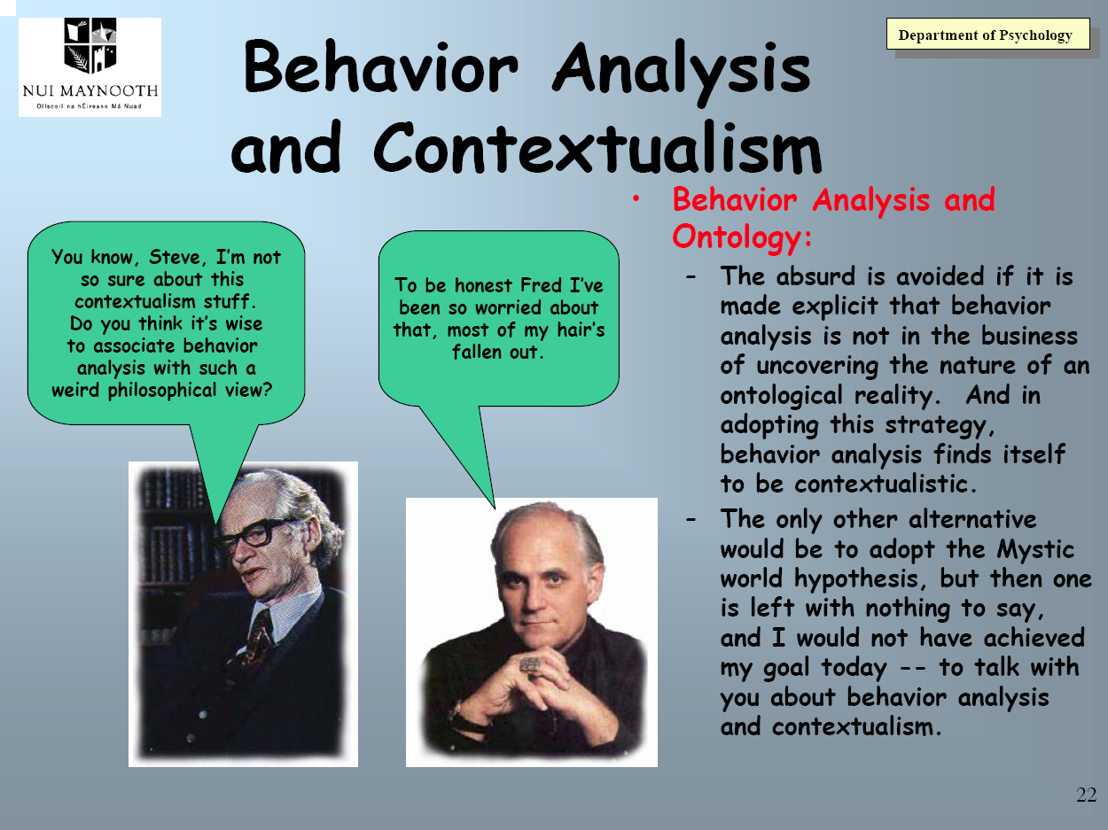
Notes:
35

Slide 36
Pragmatism or “Realism” – a choice
Monistic/holistic Contextualistic Humility of only ever considering the work as something of use for a chosen purpose i.e. truth is specifically defined as the usefulness regarding prediction and influence, with precision, scope and depth Treatment / intervention utility of the strategy is built in to every aspect of the work; philosophy / basic science / clinical Values must guide the scientific approach | Dualistic/pluralistic Mechanistic, non-contextualistic Nobility of discovery of the reality of the way the universe is truly constructed i.e. truth being assumed to be what things are really like, an ever more accurate correspondence to the reality of things Treatment / intervention utility of the strategy is a separate matter entirely requiring a subsequent research program Values not needed – this IS how things ARE
Notes:
36

Slide 37
Contextual Medicine
=
consistent
behavior / biology science

Slide 38
Contextual Behavioral Neuroscience
Contextual Behavioral Science: Creating a science more adequate to the challenge of the human condition. Hayes, Barnes-Holmes, Wilson JCBS 2012
The material state of the brain is never by itself a scientifically adequate cause of psychological action; instead neurobiological evidence relative to psychology examines the depth of psychological accounts and provides a larger scientific context for them. If a behavioral event is understood in terms of history, context, and function, nothing should appear at the neurobiological level that contradicts that understanding. If it does, then the analysis fails because it has no depth.
If, conversely, relations between precisely defined situated actions and neurobiology are obtained then we have increased our understanding of neurobiology and of behavior, because all of the factors of history, context, and function known to be important at the behavioral level can now inform our understanding of how the brain develops and functions.
As neurobiological evidence grows based on more adequate behavioral and contextual knowledge, the implications for behavioral science of neurobiological knowledge grow as well. For example, knowledge of contextual effects on brain functioning can later allow neurobiologists to provide additional clues to behavioral scientists about the possible contextual factors involved in complex performances that are not yet well understood at the psychological level, based of patterns of neurobiological responding.
Notes:
The material state of the brain is never by itself a scientifically adequate cause of psychological action; instead neurobiological evidence relative to psychology examines the depth of psychological accounts and provides a larger scientific context for them. If a behavioral event is understood in terms of history, context, and function, nothing should appear at the neurobiological level that contradicts that understanding. If it does, then the analysis fails because it has no depth.
If, conversely, relations between precisely defined situated actions and neurobiology are obtained then we have increased our understanding of neurobiology and of behavior, because all of the factors of history, context, and function known to be important at the behavioral level can now inform our understanding of how the brain develops and functions.
As neurobiological evidence grows based on more adequate behavioral and contextual knowledge, the implications for behavioral science of neurobiological knowledge grow as well. For example, knowledge of contextual effects on brain functioning can later allow neurobiologists to provide additional clues to behavioral scientists about the possible contextual factors involved in complex performances that are not yet well understood at the psychological level, based of patterns of neurobiological responding.

Slide 39
PROGRESS
IN BASIC
CONTEXTUAL BEHAVIORAL NEUROSCIENCE?

Slide 40
Michael Schlund publications 2011-13

Slide 41
Michael Schlund publications 2008-10

Slide 42
Robert Whelan publications 2013
When optimism hurts: Inflated predictions in psychiatric neuroimaging. Biological Psychiatry.
The Spread of Fear: Symbolic Generalization Mediates Graded Threat-Avoidance in Specific Phobia. The Quarterly Journal of Experimental Psychology.
The Neurobiology of Successful Abstinence. Current Opinion in Neurobiology.
Symptom overlap in anxiety and multiple sclerosis. Multiple Sclerosis Journal.
Commentary on Coming to Terms with Motivation in the Behavior-Analytic Literature by Aló and Cançado. (in press). The Psychological Record.
Establishing arbitrarily applicable relations of same and opposite with the relational completion procedure: selection-based feedback. The Psychological Record, 63, 1–20
Fractionating the impulsivity concept in adolescence. Neuropsychopharmacology 38, 250–251.

Slide 43
Robert Whelan publications 2012
Adolescent impulsivity phenotypes characterized by distinct brain networks. Nature Neuroscience - Featured article in Nature Neuroscience.
Only Low Frequency Event-Related EEG Activity is Compromised in Multiple Sclerosis: Insights From an Independent Component Clustering Analysis. PLoS ONE
The orbitofrontal cortex, substance misuse and impulsivity: can teenage rebellion be predicted through neural correlates? Future Neurology.
Very large fMRI study using the IMAGEN database: Sensitivity–specificity and population effect modeling in relation to the underlying anatomy. NeuroImage
Neural correlates of oddball detection in self-motion heading: A high-density event-related potential study of vestibular integration (2012). Experimental Brain Research
A test of the discrimination account in equivalence class formation. Learning and Motivation

Slide 44
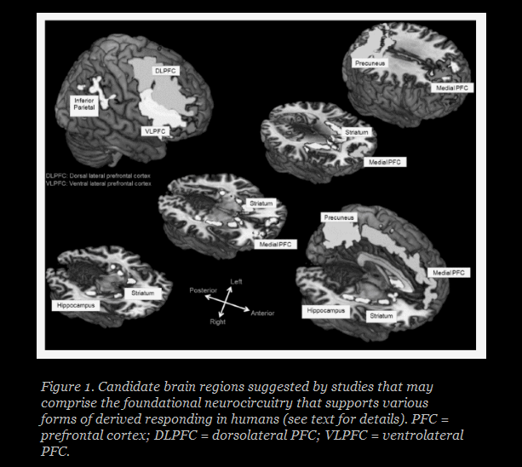
Advances in RFT Chapter 4
Rob Whelan and Mike Schlund

Slide 45
Next steps: neurobehavioural systems underlying indirect pathways of human avoidance - Simon Dymond job advert!
“Two separable processes are thought to maintain pathological forms of fear and threat-avoidance: direct and indirect. For direct threat-avoidance, pathology has involved undergoing aversive experiences.
By comparison, indirect threat-avoidance occurs because of knowledge of threats and adaptive avoidance responses acquired through description (e.g. instructions), social observation or cognitive inferences.
We believe that each pathway may be distinguished by different brain mechanisms, with each pathway potentially having a different optimal treatment for successful behaviour change.”
This research → fMRI neuroscientific level extension of:
Safe From Harm: Learned, Instructed, and Symbolic Generalization Pathways of Human Threat-Avoidance.
Simon Dymond, Michael W. Schlund, Bryan Roche, Jan De Houwer, Gary P. Freegard PLoS One 2012

Slide 46
HOW RESEARCH IN BEHAVIORAL PHARMACOLOGY INFORMS BEHAVIORAL SCIENCE
MARC N. BRANCH
UNIVERSITY OF FLORIDA – JEAB 2006
Research in behavioral pharmacology assists the experimental analysis of behavior, especially conceptualizations and theory.
3 general strategies in behavioral pharmacology research to increase understanding of behavioral processes.
Examples of the strategies and of implications of previous research for behavior theory.
Behavior analysis will advance as its theories are challenged.
BF Skinner - the brain could be "unlocked
with a molecule better than with a scalpel."

Slide 47
CONTEXTUAL MEDICINE organisational practices

Slide 48
CONTEXTUAL MEDICINE – SYSTEMS LEVEL
Corporate Externalities: A Challenge to the Further Success of Prevention Science - Anthony Biglan, Prevention Science 2011
The full benefit of prevention (medical) science will not be realized until we… influence organizational practices.
Marketing of tobacco, alcohol, and food (AND MEDICATIONS) and corporate … policies that maintain poverty are examples of practices we must influence.
(? also medical / psychiatric professional bodies and journals, the pharmaceutical industry / regulatory agencies, and University and government research funding agencies. Perhaps outside the CM SIG remit, but critical → environmental practices)
This paper analyzes the evolution of such practices in terms of their selection by economic consequences.
→ CBS scaled up to social organisational PROSOCIAL level.
Notes:
The full benefit of prevention (medical) science will not be realized until we… influence organizational practices.
Marketing of tobacco, alcohol, and food (AND MEDICATIONS) and corporate advocacy for economic policies that maintain family poverty are examples of practices we must influence.
(? also medical / psychiatric professional bodies and journals, the pharmaceutical industry / regulatory agencies, and University and government research funding agencies. Perhaps outside the CM SIG remit, but critical - environmental practices)
This paper analyzes the evolution of such practices in terms of their selection by economic consequences.
→ CBS scaled up to social organisational PROSOCIAL level.

Slide 49
CONTEXTUAL MEDICINE – SYSTEMS LEVEL
Corporate Externalities: A Challenge to the Further Success of Prevention Science - Anthony Biglan, Prevention Science 2011
A strategy for addressing these critical risk factors should include:
systematic research on the impact of corporate practices on each of the most common and costly psychological and behavior problems;
empirical analyses of the consequences that select harmful corporate practices;
assessment of the impact of policies that could affect problematic corporate practices; and
research on advocacy organizations to understand the factors that influence their growth and to help them develop effective strategies for influencing corporate externalities.

Slide 50
INTEGRATING THE HUMAN SERVICES
TO EVOLVE EFFECTIVE POLICIES
Tony Biglan & Christine Cody Oregon Research Institute
Journal of Economic Behavior and Organisation 2013
Special issue on Evolution as a framework for… Public Policy
Evolution of US Public Policy making over 30 years
Advocacy for free markets selected by benefits those who advocate for such policies
CF tobacco control movement advocacy success
These principles applied to advocacy for p0licies, programs, practices increasing prevalence of nurturing families and schools (and corporate practices, medical / psychiatric systems)
Reversal of adverse policies of dominant economic paradigm which contributes to behavioral problems

Slide 51
CM SIG – “Topics of Interest” - ACBS
Human physiology, neuroscience, medicine, and their relations within the broader field of evolutionary science.
Developing CBS-based case conceptualization … integrated with models and language familiar to medical practitioners.
Functional contextual study of the effect of drugs on human behavior - conceptual, research, and clinical.
Public health, socio-cultural, and economic issues relevant to practices of medicine incl. prescribing practices, health systems.
“I take Contextual Medicine to be an exploration of the role of biological processes and medical issues in human functioning from a functional, process-focussed, systemic, contextual viewpoint.”
Steve Hayes, from a CM List post 15/04/2013

